Slide 1
COLLECTIONS
(An easy way to manage Objects)

Slide 2
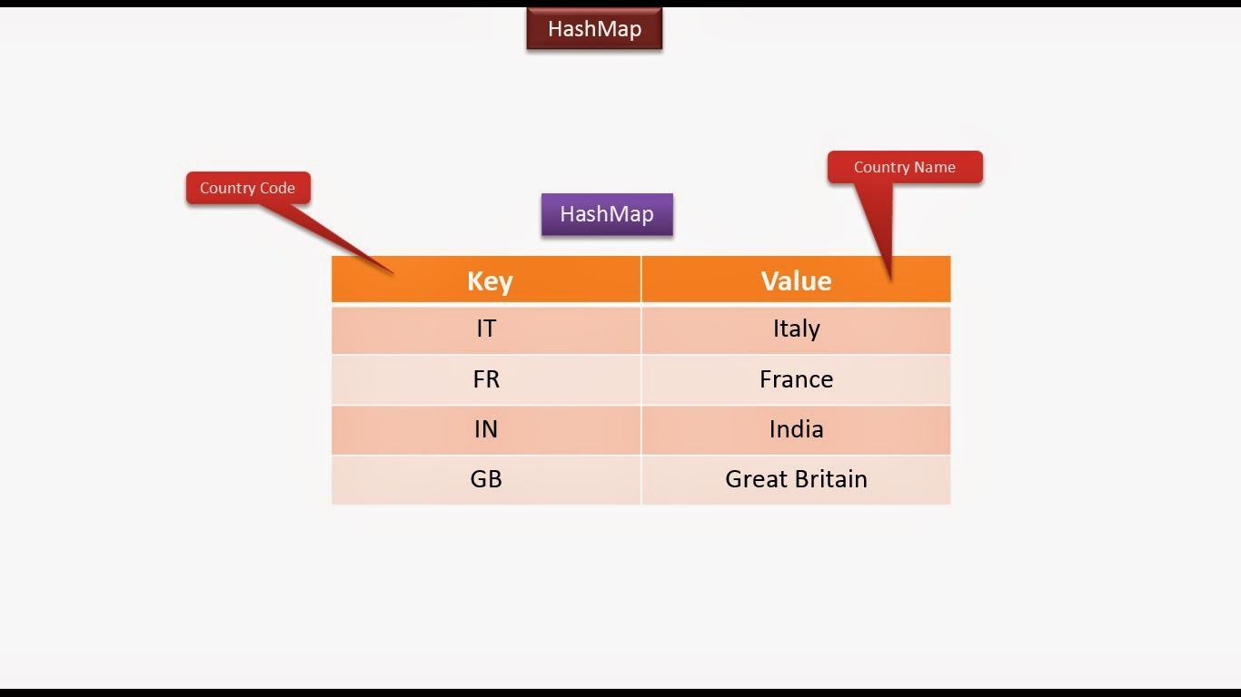
The Map Interface
A Map is an object that always stores data in pairs , called key-value pair.
Although Map does not inherit Collection interface but has methods similar to Collection

Slide 3
How values are stored in Map ?
1. A Map stores data in pairs called key-value pairs.
2. Each key-value pair saved as an object of type Entry.
3. Each Entry must have a unique keys in the Map

Slide 4
Important Methods Of Map
Object put(Object k, Object v)
Puts an Entry in the Map, overwriting any previous value associated with the key.
The key and value are k and v, respectively.
Returns null if the key did not already exist , otherwise it returns the previous value linked to the key

Slide 5
Important Methods Of Map
Object get(Object k)
Returns the value associated with the key k
If the key is not found , it returns null.

Slide 6
Important Methods Of Map
void clear( )
Removes all key/value pairs from the Map.

Slide 7
Important Methods Of Map
boolean containsKey(Object k)
Returns true if the Map contains k as a key.
Otherwise, returns false.
boolean containsValue(Object v)
Returns true if the Map contains v as a value.
Otherwise, returns false.

Slide 8
Important Methods Of Map
boolean isEmpty( )
Returns true if the Map is empty.
Otherwise, returns false.
int size( )
Returns the number of key/value pairs in the Map.

Slide 9
Important Methods Of Map
Object remove(Object k)
Removes the entry whose key equals k
Returns the previous value associated with the specified key.
Otherwise it returns null if there was no mapping for the key.

Slide 10
Important Methods Of Map
Collection values( )
Returns a Collection containing the values in the Map.

Slide 11
Important Methods Of Map
Set keySet( )
Returns a Set that contains all the keys stored in the Map.

Slide 12
Important Methods Of Map
Set entrySet( )
Returns a Set that contains the entries in the Map.
The Set contains objects of type Map.Entry.

Slide 13
Important Methods Of Entry
Object getKey( )
Returns the key corresponding to this Entry object

Slide 14
Important Methods Of Entry
Object getValue( )
Returns the value corresponding to this Entry object

Slide 15
Important Methods Of Entry
Object setValue(Object)
Replaces the old value corresponding to this entry with the specified value
Returns the old value

Slide 16
Implementation Classes
The Collections Framework provides 2 very important Map implementation:
1 - HashMap
2 - TreeMap
HashMap:
The HashMap is a class which is used to perform some basic operations such as inserting, deleting, and searching elements in a Map
TreeMap:
The TreeMap implementation is useful when we need to traverse the keys from a collection in a sorted manner. The elements added to a TreeMap must be sortable in order to work properly.

Slide 17
The HashMap class
Internally uses HashTable to store the data.
Stores data as key-value pairs
It contains only unique elements.
It is not an ordered collection.

Slide 18
The HashMap class
It neither does any kind of sorting on the stored keys and values.
Ensures that the retrieval of the object will be in constant time i.e. O(1)

Slide 19
Exercise 9
WAP to store the Names and Phone Numbers of following
members of TEAM SCA . Now retrieve these values and
display them
Name | Phone
Sachin | 9826086245
Afroz | 7992202926
Faizan | 8982585147
Ankit | 8962336876

Slide 20
Adding Data In HashMap
Map<String,Long> teamSca = new HashMap<>();
teamSca.put("Sachin", 9826086245L);
teamSca.put(“Afroz",7992202926L );
teamSca.put(“Faizan", 8982585147L);
teamSca.put(“Ankit", 8962336876L);

Slide 21
Retrieving Data From HashMap
Retrieval of data from HashMap can be done in 4 ways:
Retrieving all elements together
Retrieving only keys
Retrieving only values
Retrieving key-value pairs

Slide 22
Retrieving All Values Together
For this we simply have to pass the name of Map reference to the method println()
Example:
Map<String,Long> teamSca = new HashMap<>();
teamSca.put("Sachin", 9826086245L);
teamSca.put(“Afroz",7992202926L );
teamSca.put(“Faizan", 8982585147L);
teamSca.put(“Ankit", 8962336876L);
System.out.println(teamSca);
Output:
{Faizan=8982585147, Afroz=7992202926, Ankit=8962336876, Sachin=9826086245}

Slide 23
Retrieving Only The Keys
For this we have to do 2 things:
1. Call the method keySet() which returns a Set of keys of the HashMap
2. Use an Iterator over this Set
Example:
Map<String,Long> teamSca = new HashMap<>();
.......
Set<String> s=teamSca.keySet();
Iterator <String> it=s.iterator();
while(it.hasNext())
{
String key=it.next();
System.out.println(key);
}
Output:
Faizan
Afroz
Ankit
Sachin

Slide 24
Retrieving Only The Values
For this we have to do 2 things:
1. Call the method values() which returns a Collection of values of the HashMap
2. Use an Iterator over this Collection
Example:
Map<String,Long> teamSca = new HashMap<>();
.......
Collection<Long>c=teamSca.values();
Iterator <Long> it=c.iterator();
while(it.hasNext())
{
Long value=it.next();
System.out.println(value);
}
Output:
8982585147
7992202926
8962336876
9826086245

Slide 25
Retrieving Key-Value Pairs
For this we have to do 2 things:
Call the method entrySet( ) which returns a Set of all the data in the HashMap
Each element in this Set is an object of type Entry
Entry is an inner interface of Map and has 2 methods called getKey() and getValue()
So we will have to get an Iterator over this Entry

Slide 26
Retrieving Key-Value Pairs
Example:
Map<String,Long> teamSca = new HashMap<>();
.......
Set e=teamSca.entrySet();
Iterator it=e.iterator();
while(it.hasNext())
{
Map.Entry et=(Map.Entry)it.next();
System.out.println(et.getKey()+","+et.getValue());
}
Output:
Faizan,8982585147
Afroz,7992202926
Ankit,8962336876
Sachin,9826086245

Slide 27
Checking whether a value exists or not
To get the Value from HashMap object we use the method:
boolean containsValue(value)
This method returns true if Map contains the specified value otherwise returns false.

Slide 28
Program
import java.util.*; public class HashMapDemo{ public static void main(String args[]) { Map<String,Long> teamSca = new HashMap<>();
teamSca.put("Sachin", 9826086245L);
teamSca.put("Afroz",7992202926L );
teamSca.put(“Faizan", 8982585147L);
teamSca.put(“Ankit", 8962336876L);
boolean bool = teamSca.containsKey(“Sachin"); System.out.println(“Does Sachin is exists in HashMap : " + bool); } }
Output:
Does Sachin is exists in HashMap : true

Slide 29
Using size( ) and remove( )
To get total number of elements in a HashMap we use the method:
public int size()
To remove a particular key from the HashMap we use the method:
public Object remove(key)
This method removes the specified entry from the HashMap whose key is passed as argument and returns the deleted value

Slide 30
import java.util.*;
public class HashMapDemo {
public static void main(String args[]) {
Map<String,Long> teamSca = new HashMap<>();
teamSca.put("Sachin", 9826086245L);
teamSca.put(“Afroz",7992202926L );
teamSca.put(“Faizan", 8982585147L);
teamSca.put(“Ankit", 8962336876L);
System.out.println("The size of HashMap is : " + hm.size());
hm.remove(“Afroz");
System.out.println("The size of HashMap after alteration is : "
+ hm.size());
}
}

Slide 31
Output
Output:
The size of HashMap is : 4
The size of HashMap after alteration is : 3

Slide 32
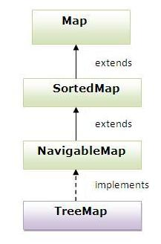
The TreeMap class
TreeMap class implements NavigableMap , SortedMap and Map interfaces.

Slide 33
The TreeMap class
1.The TreeMap class implements the Map interface by using a Binary Search Tree.
2. A TreeMap provides an efficient means of storing key/value pairs in sorted order
3. Doesn’t store duplicates

Slide 34
Example
import java.util.*;
class TreeMapDemo {
public static void main(String args[]) {
Map<String,Long> teamSca = new TreeMap<>();
teamSca.put("Sachin", 9826086245L);
teamSca.put(“Afroz",7992202926L );
teamSca.put(“Faizan", 8982585147L);
teamSca.put(“Ankit", 8962336876L);
System.out.println(teamSca);
}
}

Slide 35
Output
{Afroz=7992202926, Ankit=8962336876 Faizan=8982585147, Sachin=9826086245}

Slide 36
Example
import java.util.*;
class TreeMapDemo {
public static void main(String args[]) {
Map<String,Long> teamSca = new TreeMap<>();
teamSca.put("Sachin", 9826086245L);
teamSca.put("Afroz",7992202926L );
teamSca.put(“Faizan", 8982585147L);
teamSca.put(“Ankit", 8962336876L);

Slide 37
Set e=teamSca.entrySet();
Iterator it=e.iterator();
while(it.hasNext())
{
Entry et=(Map.Entry)it.next();
System.out.println(et.getKey()+","+et.getValue());
}
}
}

Slide 38
Output
Afroz,7992202926
Ankit,8962336876
Faizan,8982585147
Sachin,9826086245

Slide 39
Exercise 10
A Bank maintains bank account of it’s customers in the
database.
When you visit the bank and tell your account
number to the teller , he fetches your account details.
Create a collection and maintain bank accounts in that.
There should be a single entry for one account number.
We should be able to fetch the account details when an account number is supplied to the collection.

Slide 40
The program should have 3 classes:
Account : should contain 3 data members called accountNumber, name and balance . Also provide appropriate constructor and other important methods
Bank: should contain a HashMap of Account . Also provide 5 methods called :
addAccount( )
getAccount()
removeAccount()
getCount()
getAllAccounts( )

Slide 41
UseBank: This will be our driver class . It will contain code to do the following:
Create 4 Account objects and add them to the Bank .
Display their details.
Now fetch the details of a particular account by passing it’s account number
Remove an account by passing it’s account number
Display total number of Accounts

Slide 42
Exercise 11
Make changes in the Bank Application so that whenever
we display the records , they always get displayed in
sorted order of account id

Slide 43
HashMap v/s TreeMap
HashMap is useful when we need to access the Map without considering how they are added to the Map (means, unordered lookup of values using their keys).
HashMap doesn’t allow duplicated entries.
TreeMap stores the elements in a Binary Search Tree.
TreeMap allows us to retrieve the elements in some sorted order .
So we can say that TreeMap is slower than HashMap

